Slide 1

MEGAWATT POWER & TELECOMMUNICATION COMPANY LTD
COMPANY PROFILE
OUR PHILOSOPHY
EXCELLENT & QUALITY SERVICE DELIVERY

Slide 2

CONTENTS
About US
OUR Mission
OUR Vision
OUR Core Values
OUR Specialties
OUR Partners
Contact US

Slide 3
ABOUT US
Megawatt Power & Telecommunications Company Ltd is an engineering firm registered under the LAWS OF KENYA, CAP 486 of the Companies ACT, Revision 2015.
The Company has rich experience spanning across various Engineering disciplines namely; Electrical, Civil and Telecommunications.
The Company employs cost effective measures through detailed designs and lean management processes in delivering simple to complex projects.
The Company achieves this noble mission through a team of highly experienced personnel across all the fields as well as encompassing young vibrant talents with a thirst to make a mark.

Slide 4
OUR MISSION
To provide smart solutions to today’s engineering challenges by offering the most efficient and cost effective solutions.
OUR VISION
Together building a better tomorrow

Slide 5
OUR PHILOSOPHY
Excellent & Quality Service Delivery
OUR CORE VALUES
HONESTY
INTEGRITY
TIMELINESS
AGILITY
UNITY

Slide 6
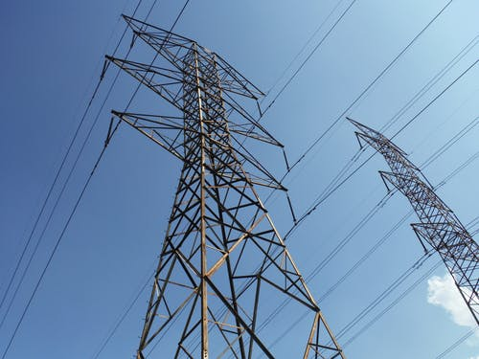
OUR SPECIALITIES
Transmission & Distribution Power lines
Survey, Design, Procurement of Plant, Installation and Commissioning of HT, MV and LV Power Lines including installation of Service Cables and customer connection
We offer complete electrical general services including Residential, Commercial and Industrial Electrical Services, High Mast Flood Lights and Street Lighting Solutions.
We also offer supply and maintenance services for all the above solutions.

Slide 7
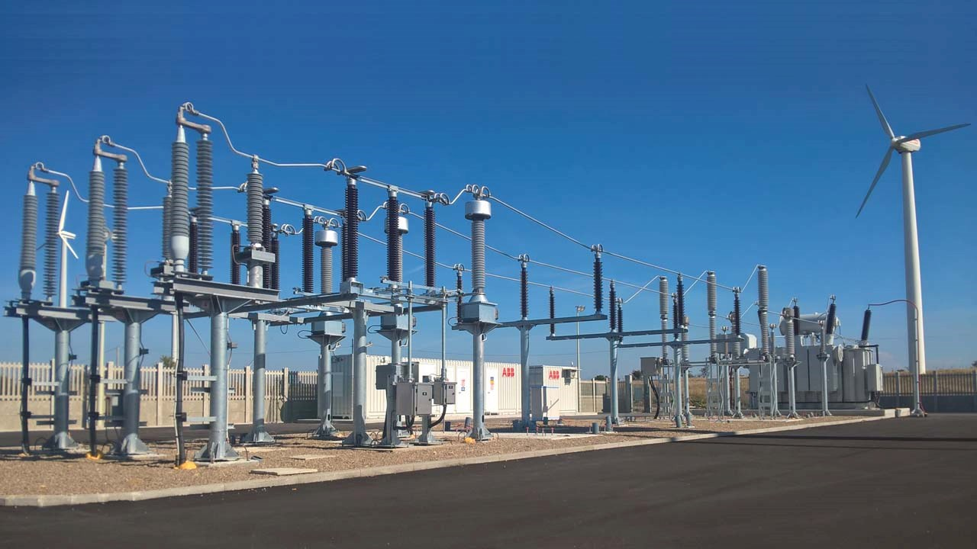
OUR SPECIALITIES
Transmission & Distribution Electrical Substations
Design, Procurement of Plant, Installation and Commissioning of Substations.
We offer complete engineering solutions for both Air Insulated Substations (AIS) and Gas Insulated Substations (GIS), including control systems and communications services.
We also offer supply and maintenance services for the above services.

Slide 8
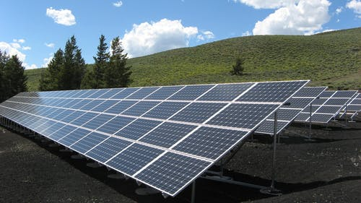
OUR SPECIALITIES
Renewable Energy Sources
Survey, Design, Procurement of Plant, Supply, Installation and commissioning of renewable energy solution systems
We offer complete solutions for renewable energy sources, including installation of smart solar systems; Grid-Tied Solar Systems, Off-Grid Solar Systems and Hybrid Solar Systems.
We also offer smart solar street lighting solutions.

Slide 9

OUR SPECIALITIES
Civil Engineering Works
Design, Procurement of Plant, Construction and Commissioning of civil and building works.
We offer complete solutions for roads and related works, buildings and perimeter security walls.
We also offer Civil work services ranging from technical consultancy to workmanship for all kinds of Civil works.

Slide 10

OUR SPECIALITIES
Fiber Rollout, Maintenance & Operation
We work on all fiber solutions (FTTH, FTTB & FTTS) from Design, Implementation and commissioning of sites
This solutions range from small projects to big projects that vary in complexity. We undertake all works from wayleave acquisition to commissioning of the fiber into the network
After completion of rollout projects, we offer quick and very responsive maintenance up to 95% Plus SLA achievement for all maintenance contracts

Slide 11

OUR SPECIALITIES
Wireless Rollout, Maintenance & Operation
We offer wireless rollout services from construction of telecommunication sites, powering and commissioning of wireless technologies
We are a solution provider in 5G/4G/3G/2G wireless network technology rollout projects for Small cell towers, Greenfield Sites, monopole sites, Wall mounted & rooftop sites
A new solution for Hybrid sites is underway to effectively reduce fuel usage in remote sites and encourage use of Solar panels as source of energy

Slide 12

OUR SPECIALITIES
Wireless Network Optimization
We offer wireless network optimization for 2G/3G/4G ensuring customers get the best quality and reliable services.
We undertake drive tests, walk tests and come up with remedies to solve shortcomings your network making it more reliable.
We are looking forward to the next generation technology, 5G hoping it will improve greatly on customers experience for your Network.

Slide 13










OUR PARTNERS

Slide 14
CONTACT US
MEGAWATT POWER & TELECOMMUNICATION COMPANY LTD
P.O. Box 14649-00100,
Nairobi, Kenya
Ngong Road, 15 Opposite Malik Heights
www.megawco.com
info@megawco.com
0722 260 464 / 0710 300 850

